Slide 1
CS3103
Machine Learning
Renewable Energy Production Prediction Using Hybrid ML Models
Group ID : 25GK26
Group Members:
2301CS31 (Mihika)
2301CS49 (Saniya Prakash)
2301CS87 (Shefali Bishnoi)
2301CS88 (Juhi Sahni)

Slide 2
Roles & Responsibilities
Name | Roll Number | Roles & Responsibilities
Mihika | 2301CS31 | Built predictive models: implemented Linear Regression and Random Forest.
Saniya Prakash | 2301CS49 | Data preprocessing: outlier detection, normalization, and feature engineering. Implemented XGBoost.
Shefali Bishnoi | 2301CS87 | Implemented SVR with multiple kernels and LSTM model. Prepared research documentation.
Juhi Sahni | 2301CS88 | Defined overall roadmap and ensured integration. Implemented CNN+LSTM hybrid model and oversee version control.

Slide 3
Problem Statement :
Renewable Energy Production Prediction Using Hybrid ML Models
MOTIVATION
OBJECTIVES
Our environment is getting worse day by day mainly because of greenhouse gases emissions because of burning of fossil fuels leading to global warming, pollution, ozone layer depletion etc . There is an urgent need to move towards cleaner sources of energy which could lead to a more sustainable future. But to truly speed up the clean energy shift, we need better predictions. Our project is motivated by the clear problem which is to match unstable renewable power like solar and wind energy with the need for a stable, low-cost power grid.
The main objective is to develop a highly accurate hybrid ML model for predicting future renewable energy output. We tested and compared five distinct machine learning models starting with simpler ones like Regression, SVR, XGBoost, and Random Forest, and progressing to the advanced deep learning model, LSTM. Our core contribution is the development and validation of the Hybrid CNN-LSTM Model. CNN captures spatial features or local patterns and LSTM captures time-based sequences or dependencies over long historical periods. This two-step process is what allows the hybrid model to outperform simpler, single-purpose models.

Slide 4
Literature Review
KEY PRIOR WORK:
Tree-based ensemble models such as XGBoost and Random Forest are widely recognized as strong baselines for renewable energy forecasting. Studies by Hastomo et al. and N. P et al. show that these models outperform traditional linear approaches due to their ability to capture complex, non-linear interactions within weather-related features [3,4]. To model temporal dependencies in energy production, Long Short-Term Memory (LSTM) networks are highly effective. As highlighted by Van Houdt et al., their gating architecture addresses vanishing gradients, enabling robust learning of long-term trends in time-series data [2]. Additionally, the high-resolution renewable energy dataset provided by Ortega et al. supports the development of advanced hybrid forecasting frameworks [1].
IDENTIFIED GAPS:
Most existing studies, including [3] and [4], focus on predicting only one type of renewable source such as solar without considering how multiple energy sources interact in real hybrid systems. This creates a gap in multi-source forecasting. Although LSTM models handle temporal patterns well [2], they are not designed to capture complex spatial relationships present in modern datasets. As shown in [1], renewable energy data often includes multiple exogenous variables, but LSTMs alone struggle to learn these combined spatio-temporal dependencies effectively.
CITATIONS:
[1] S. Rojas Ortega, P. Castro-Correa, S. Sepulveda-Mora, and J. Castro-Correa, “Renewable energy and electricity demand time series dataset with exogenous variables at 5-minute interval,” Mendeley Data, vol. 1, 2023.
[2] G. Van Houdt, C. Mosquera, and G. Nápoles, “A review on the long short-term memory model,” Artificial Intelligence Review, vol. 53, no. 1, pp. 1-44, 2020.
[3] W. Hastomo, A. Digdoyo, A. Satyo, and D. Arif, “Enhancing solar energy efficiency: Predictive modeling with XGBoost and linear regression,” JIKA (Jurnal Informatika), vol. 9, no. 1, pp. 66-74, 2025.
[4] N. P, M. Sari, and K. Kusnanto, “Predicting the potential of renewable solar energy based on weather data in Indonesia using the random forest method,” G-Tech: Jurnal Teknologi Terapan, vol. 9, no. 4, pp. 1771-1781, 2025

Slide 5
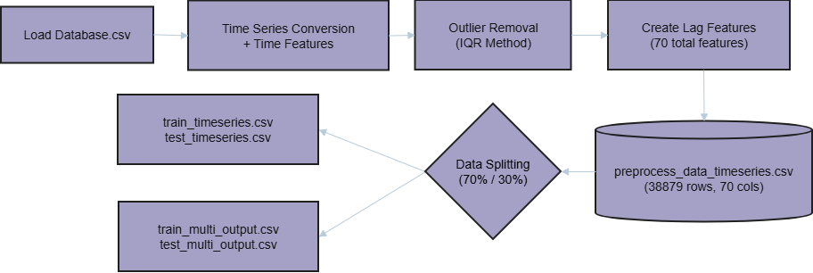
METHODOLOGY
OUR DATASET
The dataset contains 38,880 samples collected at 5-minute intervals, featuring meteorological parameters (solar irradiance DHI/DNI/GHI, wind speed, humidity, temperature) and energy production data (PV and wind generation). The dataset includes temporal features (season, day of week) and covers a complete annual cycle, enabling comprehensive modeling of renewable energy patterns [1].
PREPROCESSING

Slide 6
F
L
OW C
H
A
R
T
Training Data(70%)
Preprocessing
Outlier Detection and Removal
Preprocessed Dataset
Start
Dataset
Testing Data(30%)
Model Evaluation
Model Training
Select
Best Model
1. Multivariate Linear regression
2. Random Forest
3. XGBoost
Result and Comparison
4. SVR
5. LSTM
6. LSTM+CNN
End

Slide 7
Proposed Method
1. Data Preparation
We began with a comprehensive dataset containing solar (PV) and wind power measurements along with relevant weather variables. The data underwent standard preprocessing to ensure quality and consistency before being used for model training.
2. Model Development
Our investigation systematically compared multiple modeling approaches:
Baseline Models: We implemented traditional machine learning models including Linear Regression, Support Vector Regressor (SVR), and tree-based methods (Random Forest, XGBoost) to establish performance benchmarks.
Advanced Neural Networks: We explored deep learning architectures including:
CNN models for spatial feature extraction
LSTM networks for temporal sequence learning
Proposed Hybrid Approach: We developed a CNN-LSTM hybrid architecture that combines the strengths of both models. The CNN component automatically identifies important patterns in the data, while the LSTM component processes these patterns over time to understand temporal dynamics, ultimately generating simultaneous predictions for both solar and wind power output.
3. Model Evaluation
All models were trained using standard deep learning practices and evaluated on multiple metrics including MAE,RMSE and Adjusted R² comprehensively assess forecasting accuracy across different error dimensions.
Through this rigorous methodology, we demonstrate that our CNN-LSTM hybrid model effectively captures both spatial and temporal patterns in renewable energy data, achieving superior performance compared to all benchmarked approaches.

Slide 8
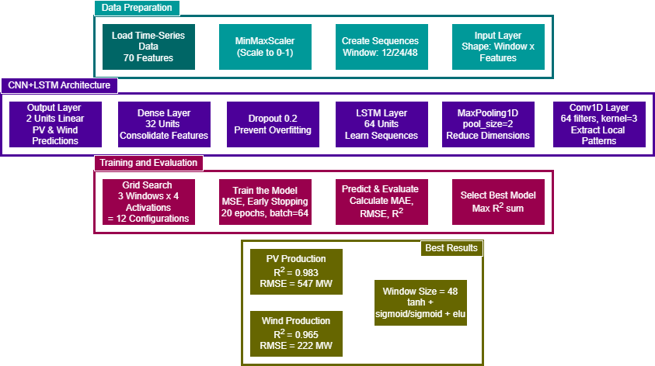
SYSTEM ARCHITECTURE

Slide 9
Summary of all configuration
Activation Function Combination | Window Size | PV_R² | Wind_R² | Sum
Conv(relu)+ LSTM( tanh/sigmoid)+Dense(relu) | 12 | 0.969 | 0.774 | 1.743
 | 24 | 0.985 | 0.739 | 1.724
 | 48 | 0.994 | 0.912 | 1.905
Conv(elu)+ LSTM(tanh/sigmoid)+Dense(relu) | 12 | 0.962 | 0.949 | 1.912
 | 24 | 0.979 | 0.836 | 1.815
 | 48 | 0.960 | 0.970 | 1.929
Conv(selu)+ LSTM(relu/hard_sigmoid)+Dense(relu) | 12 | 0.986 | 0.880 | 1.866
 | 24 | 0.964 | 0.938 | 1.902
 | 48 | 0.908 | 0.819 | 1.727
Conv(tanh)+ LSTM(sigmoid/sigmoid)+Dense(elu) | 12 | 0.976 | 0.921 | 1.897
 | 24 | 0.986 | 0.956 | 1.942
 | 48 | 0.983 | 0.965 | 1.948

Slide 10
Results
Model | PV_R² | Wind_R² | PV_MAE | Wind_MAE | Best Configuration
Linear Regression | 0.903 | 0.481 | 784.2 | 692.4
SVR(RBF) | 0.911 | 0.554 | 652.0 | 615.3 | RBF Kernel
Random Forest | 0.983 | 0.946 | 198.8 | 142.2 | -
XGBoost | 0.971 | 0.837 | 318.1 | 348.6 | -
LSTM | 0.980 | 0.962 | 506.8 | 188.2 | Window=48, tanh/hard_sigmoid
CNN+LSTM | 0.983 | 0.965 | 367.7 | 178.5 | Window=48,tanh/sigmoid/elu

Slide 11
Discussion
1.
Chosen for simplicity and interpretability, these established performance benchmarks but proved inadequate, particularly for wind prediction (R²=0.481). They failed to capture nonlinear weather patterns and temporal dependencies, showing systematic errors.
Linear Models (Baseline)
2.
Tree Based Models
Random Forest and XGBoost handled non-linear relationships effectively, achieving drastic improvements (PV R²=0.983, Wind R²=0.946). Feature analysis revealed GHI dominance for solar (80.2%) and seasonal importance for wind. However, these models still missed crucial temporal sequence patterns.
3. LSTM
Specifically designed for temporal dependencies, LSTMs with 48-sized windows captured sequential patterns effectively, achieving superior wind prediction (R²=0.962).
Our final architecture combines CNN spatial feature extraction with LSTM temporal modeling. This hybrid approach achieved peak performance (PV R²=0.983, Wind R²=0.965) by capturing both local patterns and long-term dependencies simultaneously.
4. CNN+LSTM

Slide 12
KEY OBSERVATIONS
CONCLUSION
Solar power depends heavily on GHI, while wind requires complex temporal patterns. Simple models failed for wind prediction. Our hybrid CNN-LSTM model outperformed all others (PV R²=0.983, Wind R²=0.965) by combining spatial feature extraction with temporal sequence learning, with 48-sized windows proving optimal for capturing weather transitions.
Takeaways
The CNN-LSTM hybrid delivers superior accuracy by merging spatial and temporal learning. For practical use, Random Forest offers the best speed/accuracy balance. Solar energy depends on instant weather features like GHI, while wind energy requires complex temporal patterns, demanding different modeling strategies for each energy type.
Computational demand for deep learning limits real-time use. Model performance is constrained by data quality and may not generalize to new locations. Hybrid models also sacrifice interpretability, creating a "black box" problem that can hinder trust and adoption for critical grid operations.
Future Works
Future work must explore simpler models for quick baselines and interpretability. We must also deploy the best model for real-time use, enhancing its utility with multi-step forecasting for grid management.
Limitations

Slide 13
References
[1] S. Rojas Ortega, P. Castro-Correa, S. Sepulveda-Mora, and J. Castro-Correa, “Renewable energy and electricity demand time series dataset with exogenous variables at 5-minute interval,” Mendeley Data, vol. 1, 2023. (Link)
[2] G. Van Houdt, C. Mosquera, and G. Nápoles, “A review on the long short-term memory model,” Artificial Intelligence Review, vol. 53, no. 1, pp. 1-44, 2020. (Link)
[3] W. Hastomo, A. Digdoyo, A. Satyo, and D. Arif, “Enhancing solar energy efficiency: Predictive modeling with XGBoost and linear regression,” JIKA (Jurnal Informatika), vol. 9, no. 1, pp. 66-74, 2025. (Link)
[4] N. P, M. Sari, and K. Kusnanto, “Predicting the potential of renewable solar energy based on weather data in Indonesia using the random forest method,” G-Tech: Jurnal Teknologi Terapan, vol. 9, no. 4, pp. 1771-1781, 2025 . (Link)

Slide 14
THANK YOU

